Slide 1
Object Oriented Programming
Chapter 2 - Java - Methods

Slide 2
Java - Methods

Slide 3
Java - Methods
A Java method is a collection of statements that are grouped together to perform an operation. When you call the System.out.println() method, for example, the system actually executes several statements in order to display a message on the console.
Now you will learn how to create your own methods with or without return values, invoke a method with or without parameters, and apply method abstraction in the program design.

Slide 4
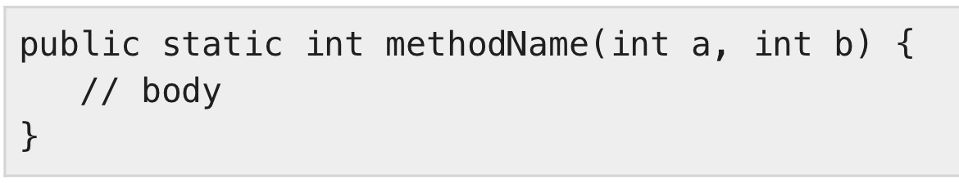
Creating Method
Considering the following example to explain the syntax of a method −
Syntax
public static − modifier
int − return type
methodName − name of the method
a, b − formal parameters
int a, int b − list of parameters

Slide 5
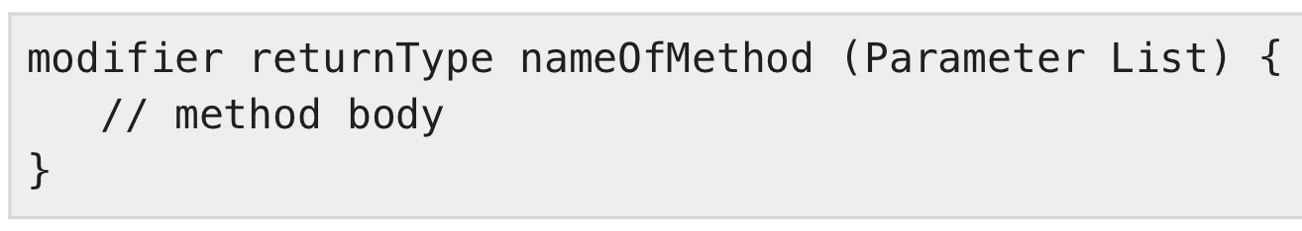
Creating Method (cont.)
Method definition consists of a method header and a method body. The same is shown in the following syntax −
Syntax
The syntax shown above includes −
modifier − It defines the access type of the method and it is optional to use.
returnType − Method may return a value.
nameOfMethod − This is the method name. The method signature consists of the method name and the parameter list.
Parameter List − The list of parameters, it is the type, order, and number of parameters of a method. These are optional, method may contain zero parameters.
method body − The method body defines what the method does with the statements.

Slide 6
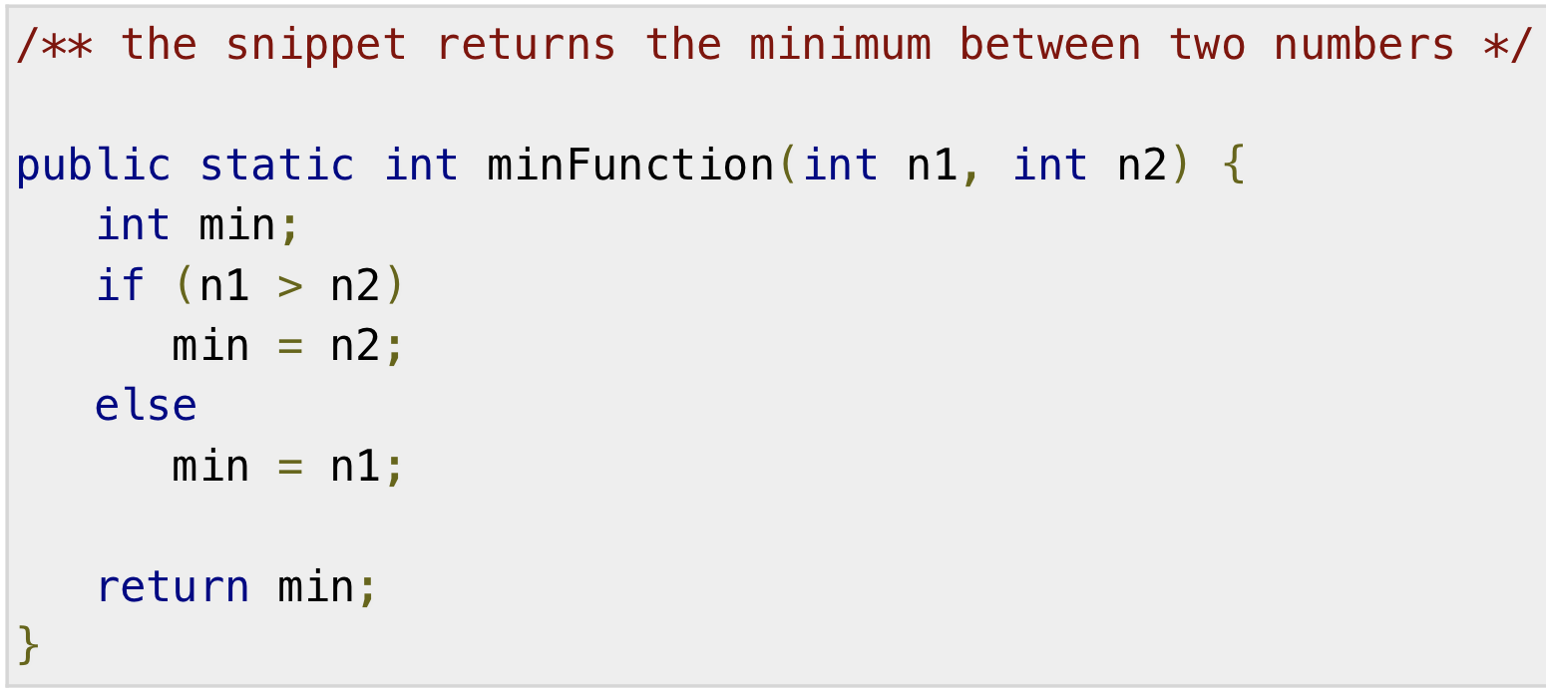
Example
Here is the source code of the above defined method called min(). This method takes two parameters num1 and num2 and returns the maximum between the two −

Slide 7
Method Calling
For using a method, it should be called. There are two ways in which a method is called i.e., method returns a value or returning nothing (no return value).
The process of method calling is simple. When a program invokes a method, the program control gets transferred to the called method. This called method then returns control to the caller in two conditions, when −
the return statement is executed.
it reaches the method ending closing brace.

Slide 8
Method Calling (cont.)
The methods returning void is considered as call to a statement. Lets consider an example −
The method returning value can be understood by the following example −

Slide 9
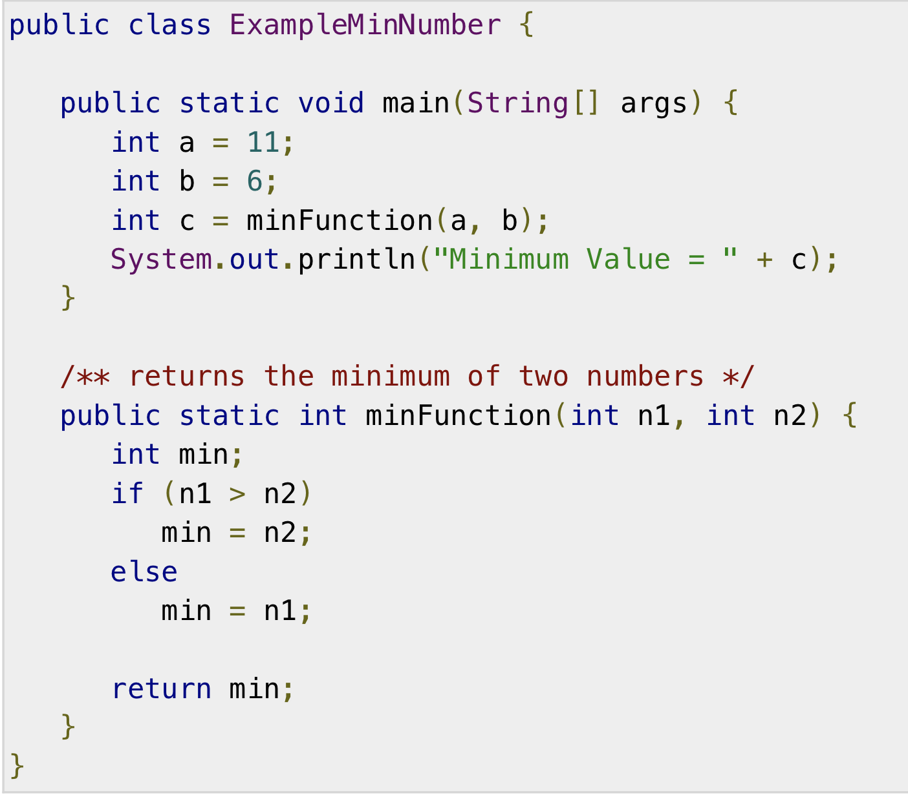
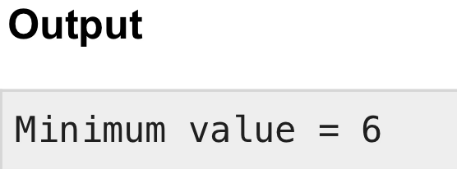
Example

Slide 10
The void Keyword
The void keyword allows us to create methods which do not return a value. Here, in the following example we're considering a void method methodRankPoints.
This method is a void method, which does not return any value. Call to a void method must be a statement i.e. methodRankPoints(255.7);.
It is a Java statement which ends with a semicolon as shown in the following example.

Slide 11
The void Keyword
The void keyword allows us to create methods which do not return a value. Here, in the following example we're considering a void method methodRankPoints.
This method is a void method, which does not return any value. Call to a void method must be a statement i.e. methodRankPoints(255.7);.
It is a Java statement which ends with a semicolon as shown in the following example.

Slide 12
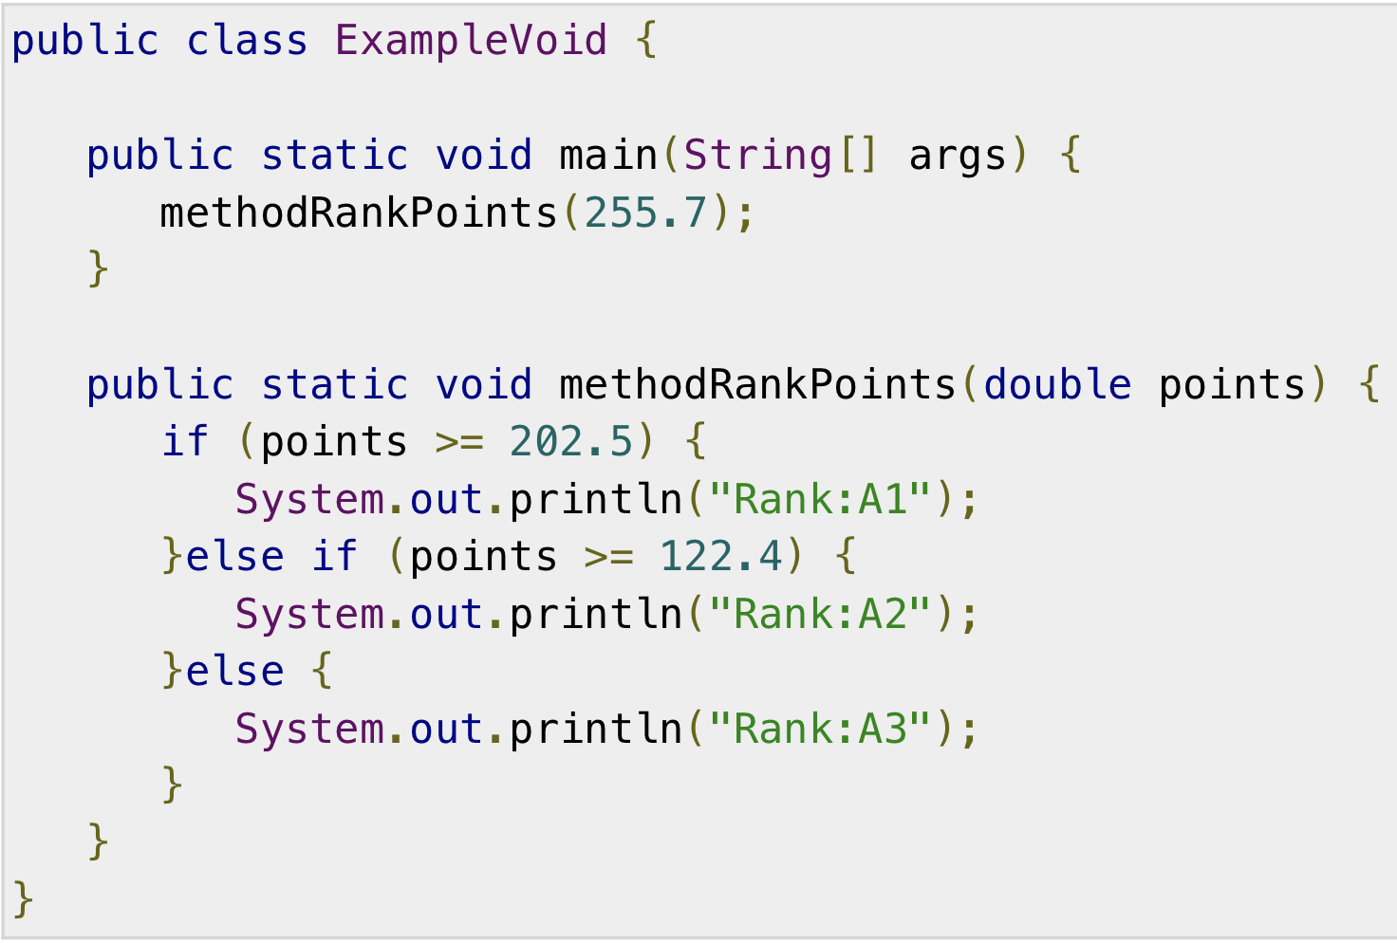

Example

Slide 13
Passing Parameters by Value
While working under calling process, arguments is to be passed. These should be in the same order as their respective parameters in the method specification. Parameters can be passed by value or by reference.
Passing Parameters by Value means calling a method with a parameter. Through this, the argument value is passed to the parameter.
Example
The program on the next slide shows an example of passing parameter by value. The values of the arguments remains the same even after the method invocation.

Slide 14
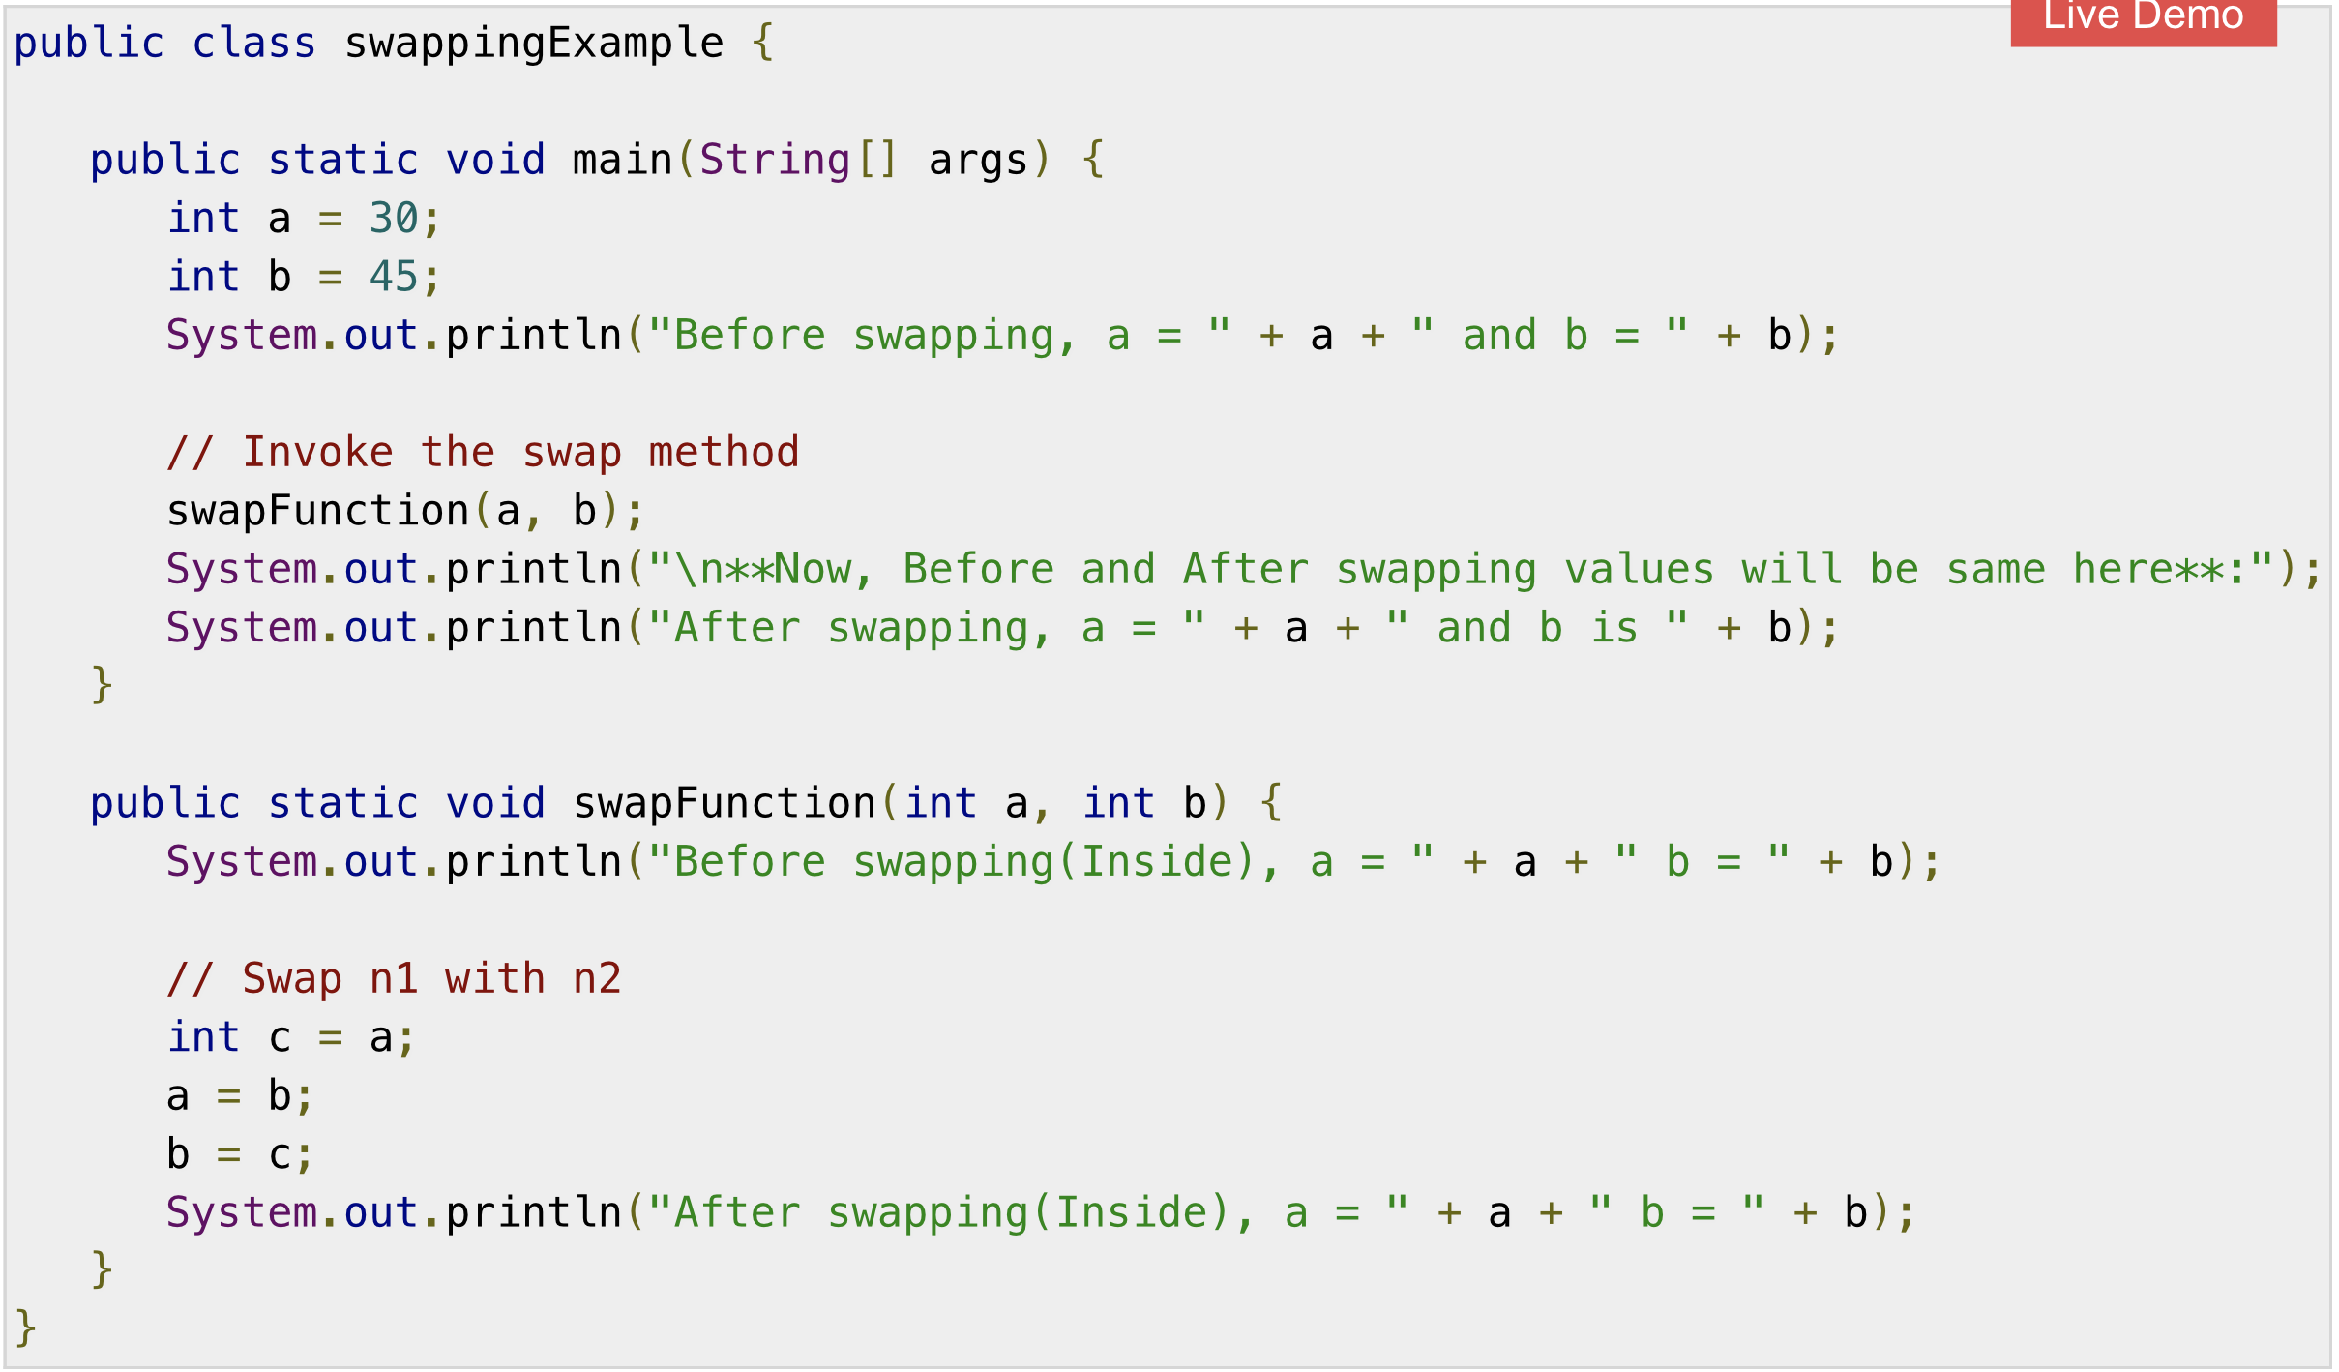
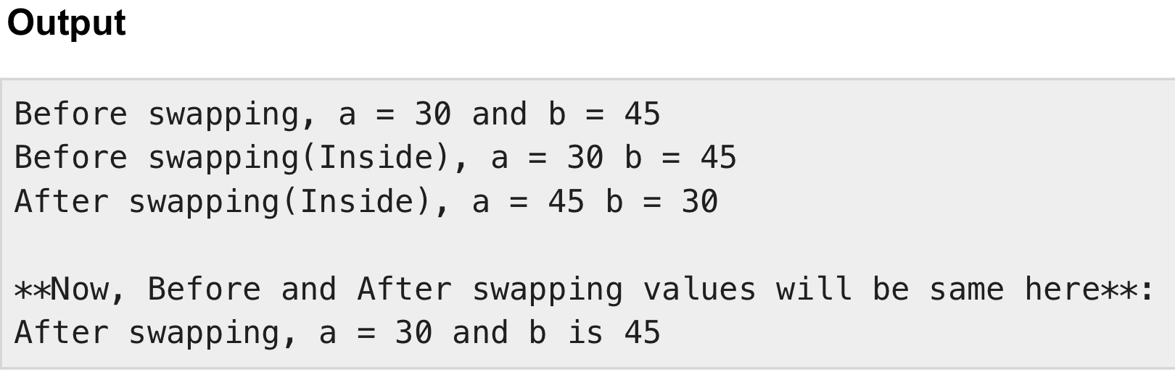

Slide 15
Method Overloading
When a class has two or more methods by the same name but different parameters, it is known as method overloading. It is different from overriding. In overriding, a method has the same method name, type, number of parameters, etc.
Let’s consider the example discussed earlier for finding minimum numbers of integer type. If, let’s say we want to find the minimum number of double type. Then the concept of overloading will be introduced to create two or more methods with the same name but different parameters.

Slide 16
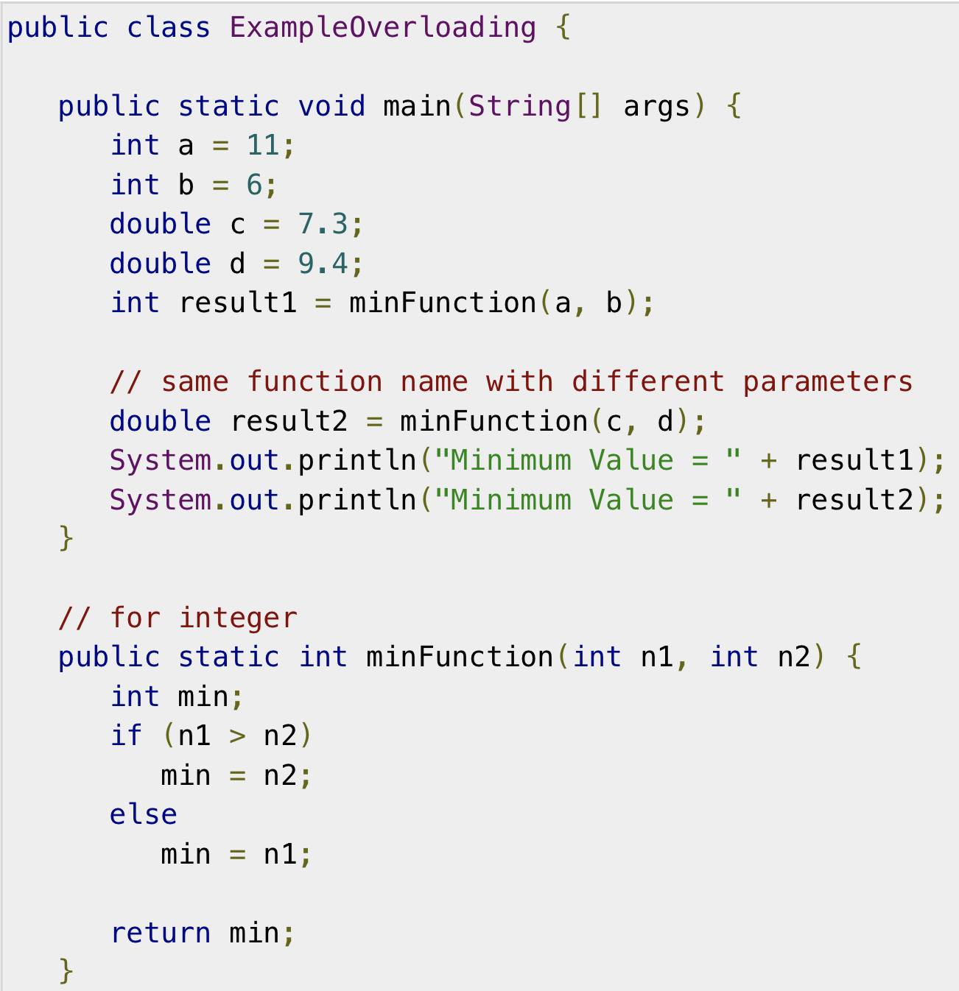
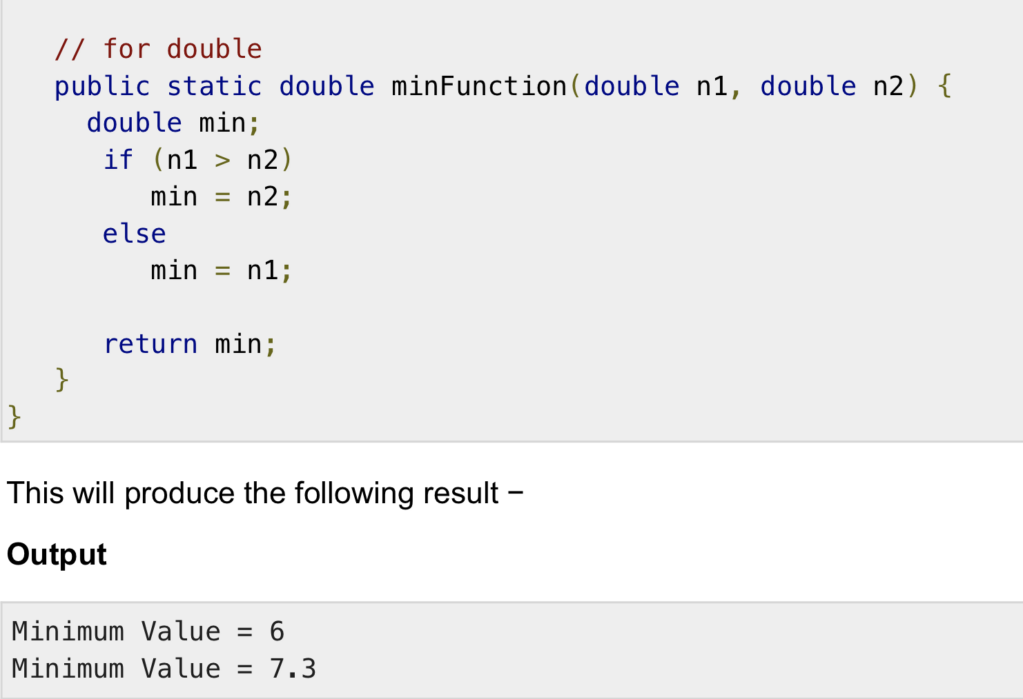
Example

